Slide 1


COMP47590
Advanced Machine Learning
RL - Temporal Difference Learning
Dr. Brian Mac Namee

Slide 2
Information
Email: Brian.MacNamee@ucd.ie
Course Materials: All material posted on UCD CS moodlehttps://csmoodle.ucd.ie/moodle/course/view.php?id=663
Enrolment key UCDAdvML2019

Slide 3
artificial intelligence
recognising
deep
learning
forecasting
data science
machine
learning
generating
organising
controlling
Reinforcement Learning

Slide 4
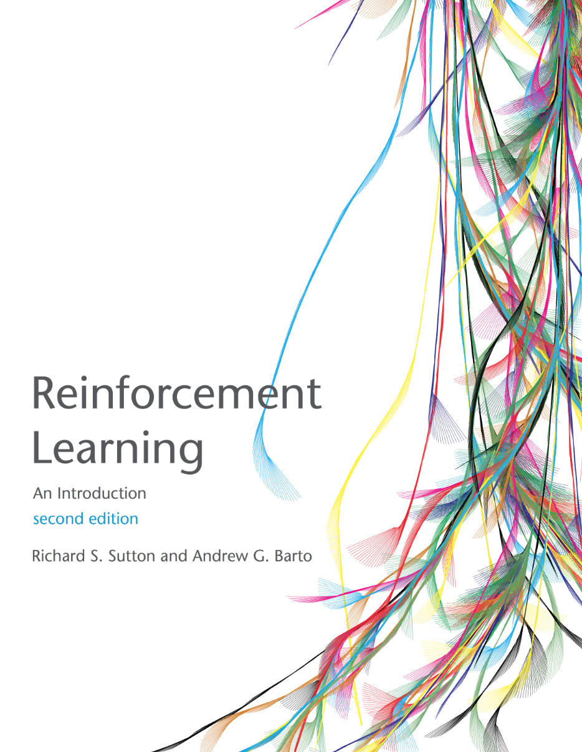
Reference Book
Much of the content in this section will follow “Reinforcement Learning An Introduction”, 2nd Edition, Richard S. Sutton and Andrew G. Barto, MIT Press, 2018 (to appear)
A legitimate online version of this book is available at:
www.incompleteideas.net/book/the-book-2nd.html

Slide 5
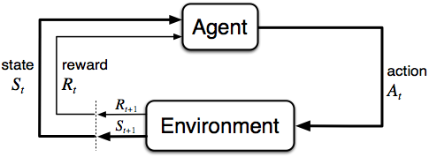
Reinforcement Learning: An Introduction , Second edition, in progress Richard S. Sutton and Andrew G. Barto, MIT Press, 2017
www.incompleteideas.net/book/the-book-2nd.html

Slide 6
Reinforcement Learning
Reward
Policy
Value Function
Environment Model

Slide 7
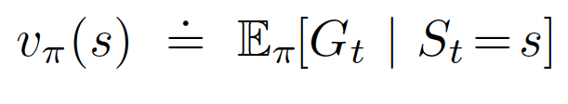
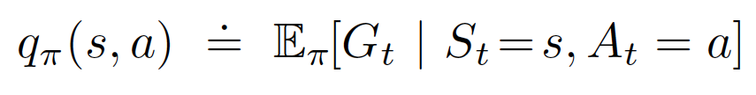
Policies & Value Functions
The value of a state s under a policy π is the expected return when starting in state s and taking actions following π thereafter:
We can similarly define the value of taking an action a in state s under policy π as:

Slide 8
Optimal Policies
All optimal policies share the same optimal state-value function
And the optimal action-value function

Slide 9
Categorising RL Approaches

Slide 10
Policy Evaluation & Policy Improvement
In reinforcement learning there are two key tasks going on
Policy evaluation: computing the state value function v_{π} for for an arbitrary policy π
Also referred to as the prediction problem
Policy improvement: based on the value function we can try to find better policies
Policy iteration brings these two together

Slide 11
Policy Iteration
Once a policy, π, has been improved using v_{π} to yield a better policy, π′, we can then compute v_{π}′ and improve it again to yield an even better π′′
policy evaluation
policy improvement
“greedification”

Slide 12
Generalized Policy Iteration
Policy iteration consists of two simultaneous, interacting processes
one making the value function consistent with the current policy (policy evaluation)
making the policy greedy with respect to the current value function (policy improvement)
Generalized Policy Iteration (GPI): any interaction of policy evaluation and policy improvement, independent of their granularity

Slide 13
Generalized Policy Iteration
Reinforcement Learning: An Introduction , Second edition, in progress Richard S. Sutton and Andrew G. Barto, MIT Press, 2017
www.incompleteideas.net/book/the-book-2nd.html

Slide 14
Categorising RL Approaches
We can categorise RL approaches based on how much of the search space they expore when perfoming policy iteration
Exhaustive search methods
Dynamic programming methods
Monte Carlo methods
Temporal difference methods

Slide 15
Exhausitve Search
St
Reinforcement Learning: An Introduction , Second edition, in progress Richard S. Sutton and Andrew G. Barto, MIT Press, 2017
www.incompleteideas.net/book/the-book-2nd.html
T
T
T
T
T
T
T
T
T
T
T
T
T

Slide 16
Dynamic Programming
St
Reinforcement Learning: An Introduction , Second edition, in progress Richard S. Sutton and Andrew G. Barto, MIT Press, 2017
www.incompleteideas.net/book/the-book-2nd.html
T
T
T
T
T
T
T
T
T
T
T
T
T

Slide 17
Dynamic Programming
St
T
T
T
T
T
T
T
T
T
T
T
T
T

Slide 18
Monte Carlo Methods
St
Reinforcement Learning: An Introduction , Second edition, in progress Richard S. Sutton and Andrew G. Barto, MIT Press, 2017
www.incompleteideas.net/book/the-book-2nd.html
T
T
T
T
T
T
T
T
T
T
T
T
T
T
T
T
T
T
T
T

Slide 19
Monte Carlo Methods
St
T
T
T
T
T
T
T
T
T
T
T
T
T
T
T
T
T
T
T
T

Slide 20
Temporal Difference Methods
St
Reinforcement Learning: An Introduction , Second edition, in progress Richard S. Sutton and Andrew G. Barto, MIT Press, 2017
www.incompleteideas.net/book/the-book-2nd.html
T
T
T
T
T
T
T
T
T
T
T
T
T
T
T
T
T
T
T
T

Slide 21
Temporal Difference Methods
St
T
T
T
T
T
T
T
T
T
T
T
T
T
T
T
T
T
T
T
T

Slide 22
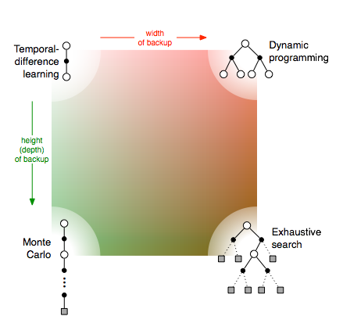
Reinforcement Learning: An Introduction , Second edition, in progress Richard S. Sutton and Andrew G. Barto, MIT Press, 2017
www.incompleteideas.net/book/the-book-2nd.html

Slide 23
TD Methods Bootstrap and Sample
Bootstrapping: update estimates of the values of states based on estimates of the values of successor states - they update estimates on the basis of other estimates
Sampling: update does not involve an expected value, but is sampled from experience

Slide 24
TD Methods Bootstrap and Sample
Bootstrapping: update involves an estimate
MC does not bootstrap
DP bootstraps
TD bootstraps
Sampling: update does not involve an expected value
MC samples
DP does not sample
TD samples

Slide 25
Temporal Difference Learning

Slide 26
𝜀-Greedy Policy
The basic action selection policy in temporal difference learning is the 𝜀-greedy policy
With a probability of 1 - 𝜀 choose the action determined by the policy
With a probability of 𝜀 choose a random action with uniform probability across actions
This is perhaps the simplest way to balance exploration and exploitation

Slide 27
Learning An Action-Value Function
Estimate qπ for the current policy π

Slide 28
On Policy Versus Off Policy Control
There are two broad categories of control problem solutions used in temporal difference learning:
On-policy methods attempt to evaluate or improve the policy that is used to make decisions
Off-policy methods evaluate or improve a policy different from that used to generate the data

Slide 29
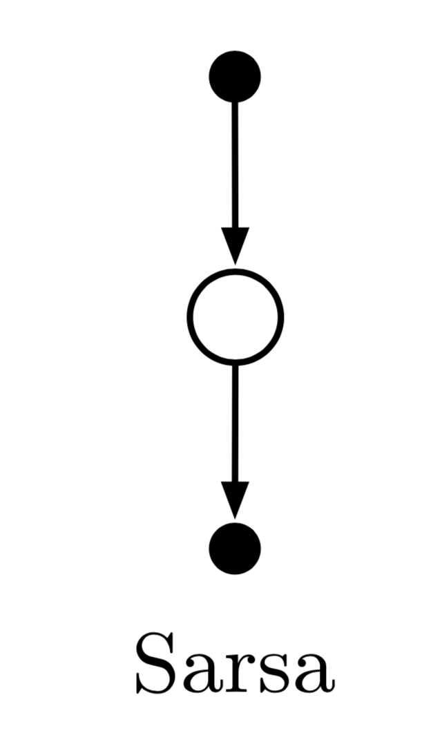
Sarsa: On-Policy TD Control
An on-policy control method that always updates the policy to be greedy with respect to the current estimate

Slide 30
Sarsa: On-Policy TD Control

Slide 31
Q-Learning: Off-Policy TD Control
An off-policy control method that updates the policy taking into account best possible actions, rather than just those determined by the policy

Slide 32
Q-Learning: Off-Policy TD Control

Slide 33
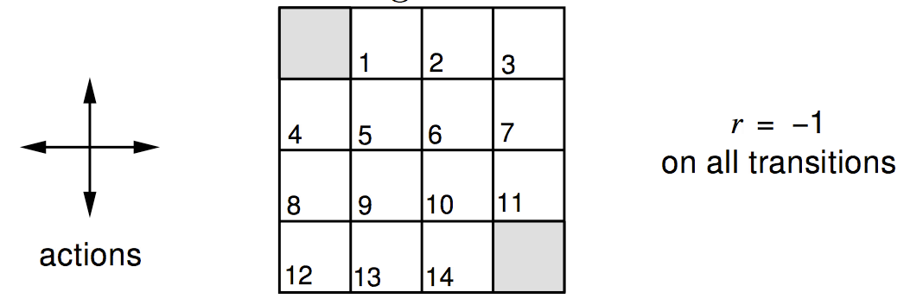
Gridworlds
R
Reinforcement Learning: An Introduction , Second edition, in progress Richard S. Sutton and Andrew G. Barto, MIT Press, 2017
www.incompleteideas.net/book/the-book-2nd.html
An undiscounted episodic task
Nonterminal states: 1, 2, . . ., 14;
One terminal state (shown twice as shaded squares)
Actions that would take agent off the grid leave state unchanged
Reward is –1 until the terminal state is reached

Slide 34
Gridworlds
S | 1 | 2
3 | 4 | 5
6 | 7 | 8
9 | 10 | G
An undiscounted episodic task
Nonterminal states: S, 1, 2, . . ., 10;
One terminal state (shown as G)
Actions that would take agent off the grid leave state unchanged
Reward is –1 until the terminal state is reached, 50 at goal
Actions
Transitions
R = -1
Goal
R = 50

Slide 35
S | 1 | 2
3 | 4 | 5
6 | 7 | 8
9 | 10 | G
Actions
Transitions
R = -1
Goal
R = 50

Slide 36
Gridworlds
S | 1 | 2
3 | 4 | 5
6 | 7 | 8
9 | 10 | G
Actions
2
3
Transitions
R = -1
Goal
R = 50
1
4
S
5
G
6
10
9
8
7

Slide 37
Gridworlds
S | 1 | 2
3 | 4 | 5
6 | 7 | 8
9 | 10 | G
Actions
State | Action | R | Q(s, a)
S | D
S | R
1 | D
1 | L
1 | R
2 | D
2 | L
2 | R
3 | U
3 | D
3 | R
State | Action | R | Q(s, a)
4 | U
4 | R
4 | D
4 | L
5 | U
5 | R
5 | D
6 | U
6 | D
6 | R
7 | U
7 | R
7 | D
7 | L
State | Action | R | Q(s, a)
8 | U
8 | R
8 | D
9 | U
9 | R
10 | U
10 | D
10 | R
G | -
Transitions
R = -1
Goal
R = 50

Slide 38
Gridworlds
S | 1 | 2
3 | 4 | 5
6 | 7 | 8
9 | 10 | G
Actions
State | Action | R | Q(s, a)
S | D | -1
S | R | -1
1 | D | -1
1 | L | -1
1 | R | -1
2 | D | -1
2 | L | -1
2 | R | -1
3 | U | -1
3 | D | -1
3 | R | -1
State | Action | R | Q(s, a)
4 | U | -1
4 | R | -1
4 | D | -1
4 | L | -1
5 | U | -1
5 | R | -1
5 | D | -1
6 | U | -1
6 | D | -1
6 | R | -1
7 | U | -1
7 | R | -1
7 | D | -1
7 | L | -1
State | Action | R | Q(s, a)
8 | U | -1
8 | R | -1
8 | D | 50
9 | U | -1
9 | R | -1
10 | U | -1
10 | D | -1
10 | R | 50
G | - | 0
Transitions
R = -1
Goal
R = 50

Slide 39
Gridworlds
S | 1 | 2
3 | 4 | 5
6 | 7 | 8
9 | 10 | G
Actions
State | Action | R | Q(s, a)
S | D | -1 | 0.01
S | R | -1 | 0.02
1 | D | -1 | 0.01
1 | L | -1 | 0.03
1 | R | -1 | 0.02
2 | D | -1 | 0.01
2 | L | -1 | 0.03
2 | R | -1 | 0.02
3 | U | -1 | 0.04
3 | D | -1 | 0.01
3 | R | -1 | 0.02
State | Action | R | Q(s, a)
4 | U | -1 | 0.04
4 | R | -1 | 0.02
4 | D | -1 | 0.01
4 | L | -1 | 0.03
5 | U | -1 | 0.04
5 | R | -1 | 0.02
5 | D | -1 | 0.01
6 | U | -1 | 0.04
6 | D | -1 | 0.01
6 | R | -1 | 0.02
7 | U | -1 | 0.04
7 | R | -1 | 0.02
7 | D | -1 | 0.01
7 | L | -1 | 0.03
State | Action | R | Q(s, a)
8 | U | -1 | 0.04
8 | R | -1 | 0.02
8 | D | 50 | 0.01
9 | U | -1 | 0.04
9 | R | -1 | 0.02
10 | U | -1 | 0.04
10 | D | -1 | 0.01
10 | R | 50 | 0.02
G | - | 0 | 0
Transitions
R = -1
Goal
R = 50

Slide 40
Gridworlds
S | 1 | 2
3 | 4 | 5
6 | 7 | 8
9 | 10 | G
Actions
State | Action | R | Q(s, a)
S | D | -1
S | R | -1
1 | D | -1
1 | L | -1
1 | R | -1
2 | D | -1
2 | L | -1
2 | R | -1
3 | U | -1
3 | D | -1
3 | R | -1
State | Action | R | Q(s, a)
4 | U | -1
4 | R | -1
4 | D | -1
4 | L | -1
5 | U | -1
5 | R | -1
5 | D | -1
6 | U | -1
6 | D | -1
6 | R | -1
7 | U | -1
7 | R | -1
7 | D | -1
7 | L | -1
State | Action | R | Q(s, a)
8 | U | -1
8 | R | -1
8 | D | 50
9 | U | -1
9 | R | -1
10 | U | -1
10 | D | -1
10 | R | 50
G | - | 0
Transitions
R = -1
Goal
R = 50

Slide 41
Sarsa: On-Policy TD Control

Slide 42
Sarsa: On-Policy TD Control

Slide 43
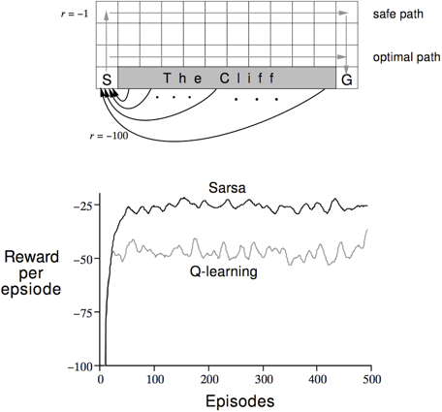
Example: Cliffwalking
Reinforcement Learning: An Introduction , Second edition, in progress Richard S. Sutton and Andrew G. Barto, MIT Press, 2017
www.incompleteideas.net/book/the-book-2nd.html

Slide 44
Example: Cliffwalking
Reinforcement Learning: An Introduction , Second edition, in progress Richard S. Sutton and Andrew G. Barto, MIT Press, 2017
www.incompleteideas.net/book/the-book-2nd.html

Slide 45
Summary

Slide 46
Summary
We have looked at the most common reinforcement learning paradigm - temporal difference learning
We introduced the ideas of
SARSA learning (on policy)
Q learning (off-policy)

Slide 47
Questions
?

